Slide 1
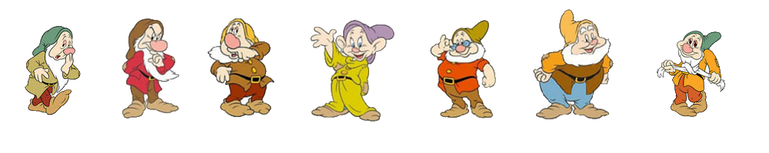
(Mis)Using Personas with
The Seven Dwarfs
Persona Pack

Slide 2
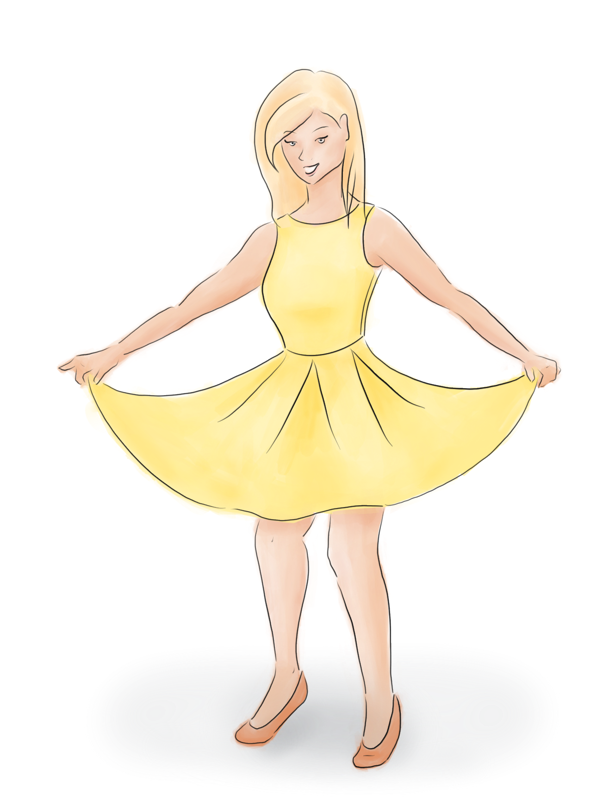
Dwarf Personas
Happy
The Temporary One
Content, open-minded, forgiving
Willing to let small things go
No expectations
Mood / mental state could change at any time
“Sounds great!”

Slide 3
Dwarf Personas
Happy
The Temporary One
Content, open-minded, forgiving
Willing to let small things go
No expectations
Mood / mental state could change at any time
“Sounds great!”
Ideas to develop further:
Situation: Playing games on holiday with no time pressures and low stress
Priority: Nice design, fun to use
Impact: Low risk unless pushed towards a different mental state
Casual user
Technically proficient
Physically able

Slide 4
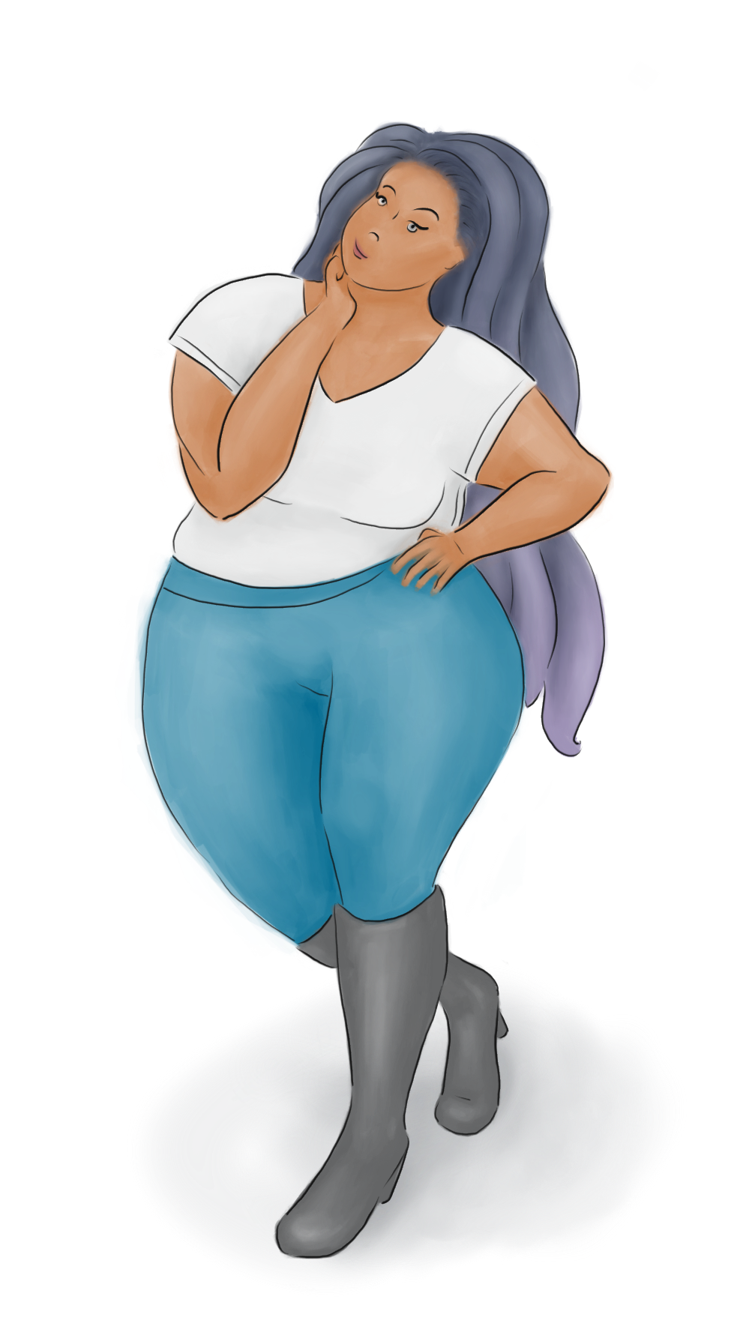
Dwarf Personas
Doc
The Picky One
Suspicious, difficult to impress
Easily turned off
Detail oriented
Prefers specificity over ambiguity
Can be distracted by lots of options or comparisons
“Hmm, I’m not sure about that.”

Slide 5
Dwarf Personas
Doc
The Picky One
Suspicious, difficult to impress
Easily turned off
Detail oriented
Prefers specificity over ambiguity
Can be distracted by lots of options or comparisons
“Hmm, I’m not sure about that.”
Ideas to develop further:
Situation: Learning about privacy and trying to find a secure email provider
Priority: Accurate, clearly presented information
Impact:
  Mistrust => non-adoption
  Confusion and abandonment of secure email => stuck with non-secure email and less privacy

Slide 6
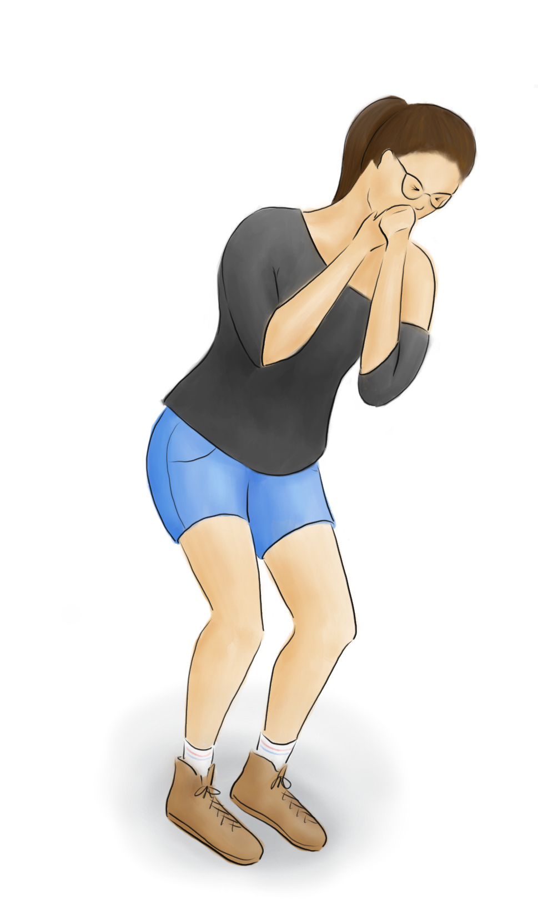
Dwarf Personas
Sneezy
The Distracted One
Forgetful, erratic
Short attention span
Multi-tasker
Doesn’t like long or complicated workflows
Will stop mid-flow and continue later
“Sorry, did you ask me something?”

Slide 7
Dwarf Personas
Sneezy
The Distracted One
Forgetful, erratic
Short attention span
Multi-tasker
Doesn’t like long or complicated workflows
Will stop mid-flow and continue later
“Sorry, did you ask me something?”
Ideas to develop further:
Situation: Trying to make arrangements for a trip, across several sites – just one task on a list of to dos
Priority: Quick, simple workflow; ample time to complete booking / purchase
Impact:
  Incomplete booking => ruined trip
  Booking the wrong thing => extra stress to correct the booking
  Session times out => annoyance and wasted time

Slide 8
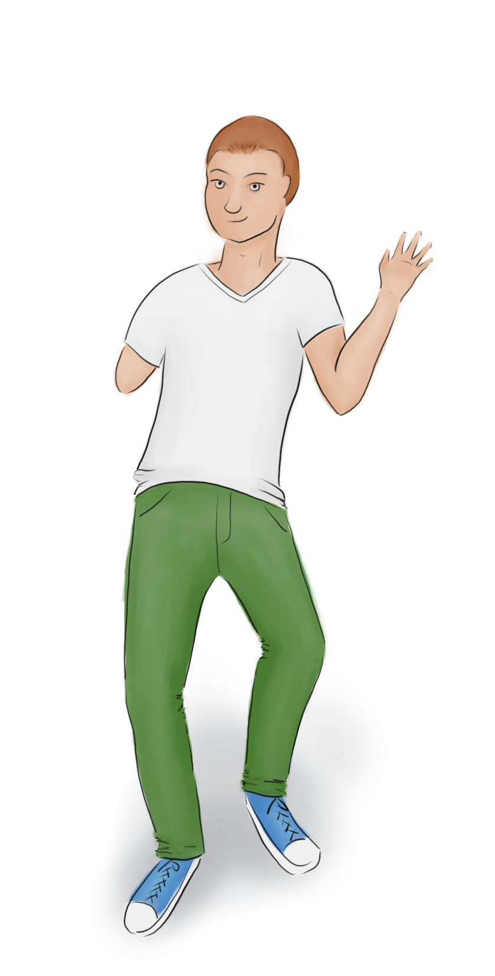
Dwarf Personas
Dopey
The Confused One
Unsure / overwhelmed
Takes comfort in familiar patterns
Seeks information / guides
Prone to errors
“Shit, what did I just do?”

Slide 9
Dwarf Personas
Dopey
The Confused One
Unsure / overwhelmed
Takes comfort in familiar patterns
Seeks information / guides
Prone to errors
“Shit, what did I just do?”
Ideas to develop further:
Situation: Using internal systems at a new company to change a customer’s billing information
Priority: Clear instructions and warning messages
Impact:
  Wrong action taken => customer is charged too much
  Customer complains => job is at risk

Slide 10
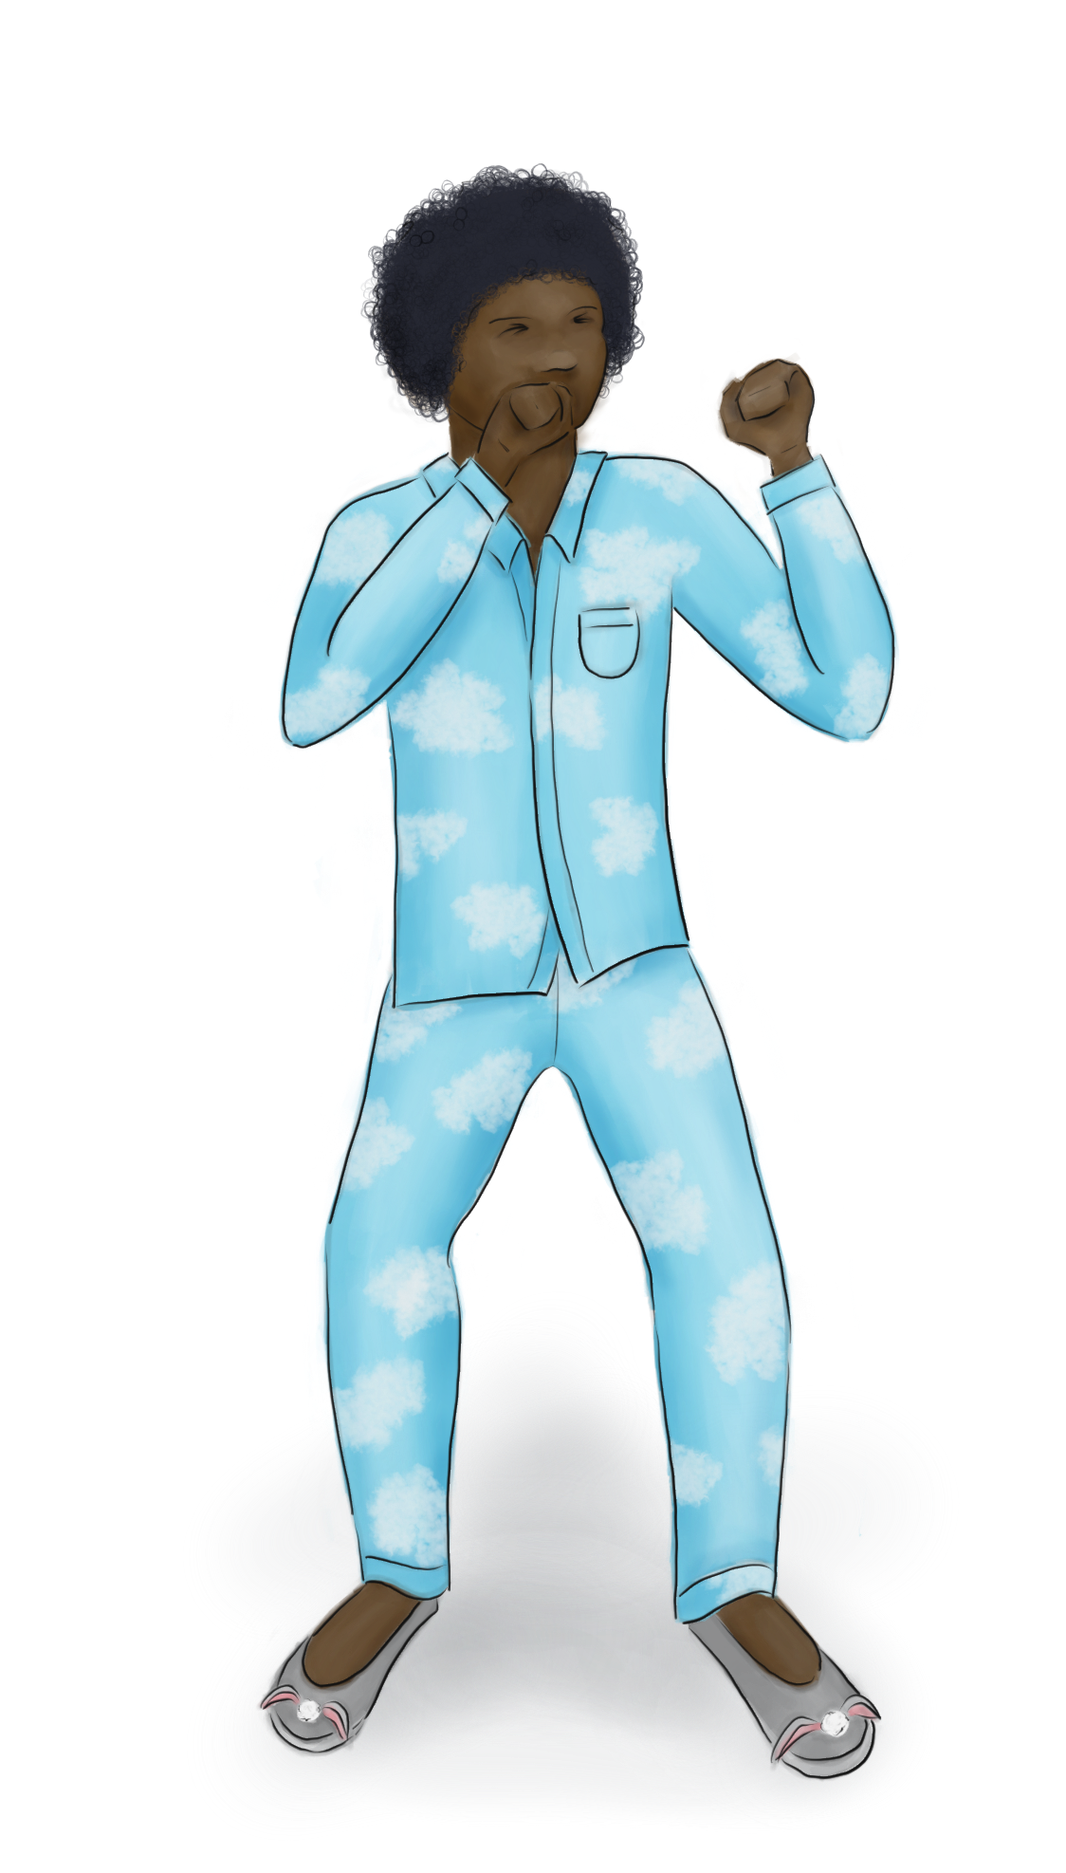
Dwarf Personas
Sleepy
The Exhausted One
Mentally / physically exhausted
Stressed, high cognitive load
Impatient, low tolerance for issues
“On the edge” – mood / mental state could worsen at any time
“I really don’t have time for this right now.”

Slide 11
Dwarf Personas
Sleepy
The Exhausted One
Mentally / physically exhausted
Stressed, high cognitive load
Impatient, low tolerance for issues
“On the edge” – mood / mental state could worsen at any time
“I really don’t have time for this right now.”
Ideas to develop further:
Situation: Travelling frequently across time zones and using a calendar app to keep track of meetings, flight times, etc.
Priority: Self-explanatory features
Impact:
  Time zones for calendar appointments aren’t clear => stress, inconvenience, cost of having to rebook missed flights
  Appointment saved in the wrong time zone => missed meetings => lost work, money, reputation

Slide 12
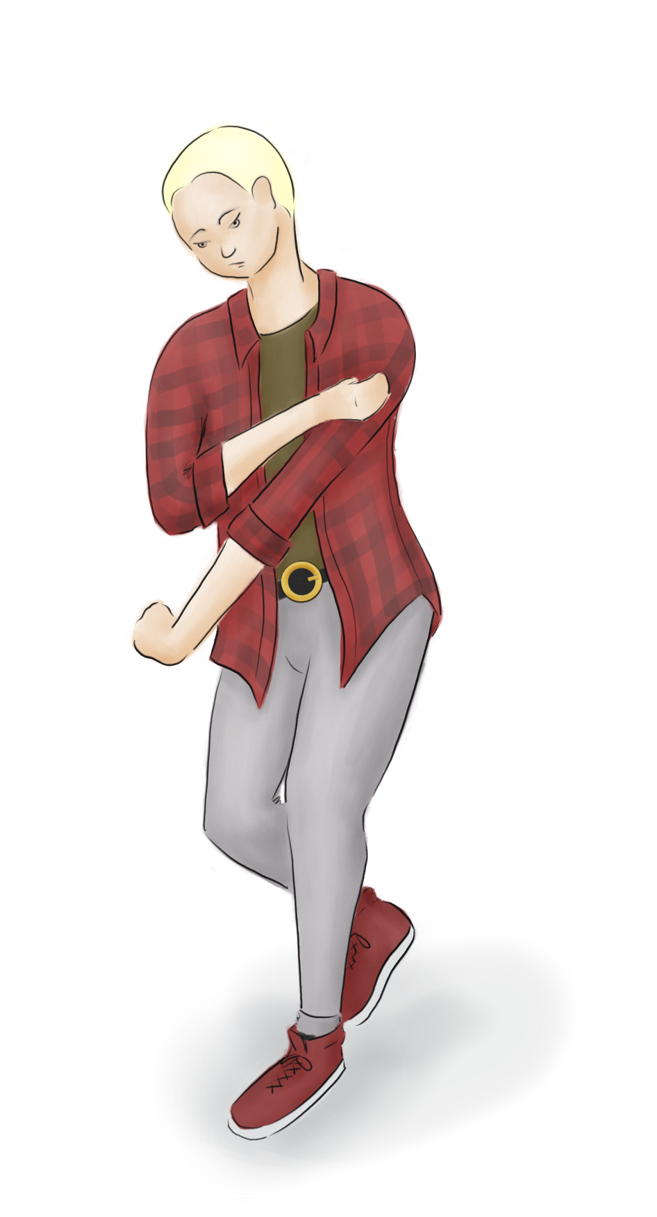
Dwarf Personas
Bashful
The Anxious One
Shy, reserved, nervous
Worried about making a mistake
Sometimes avoids taking action “just in case”
Willingness to seek help can vary
“Umm, I don’t know.”

Slide 13
Dwarf Personas
Bashful
The Anxious One
Shy, reserved, nervous
Worried about making a mistake
Sometimes avoids taking action “just in case”
Willingness to seek help can vary
“Umm, I don’t know.”
Ideas to develop further:
Situation: Moved to a different country and uses websites in non-native language
Priority: Localisation, helpful graphics
Impact:
  Tax information doesn’t translate well => wrong options selected and tax is under/over paid
  Large blocks of text displayed as pictures or PDFs => text can’t be easily translated

Slide 14
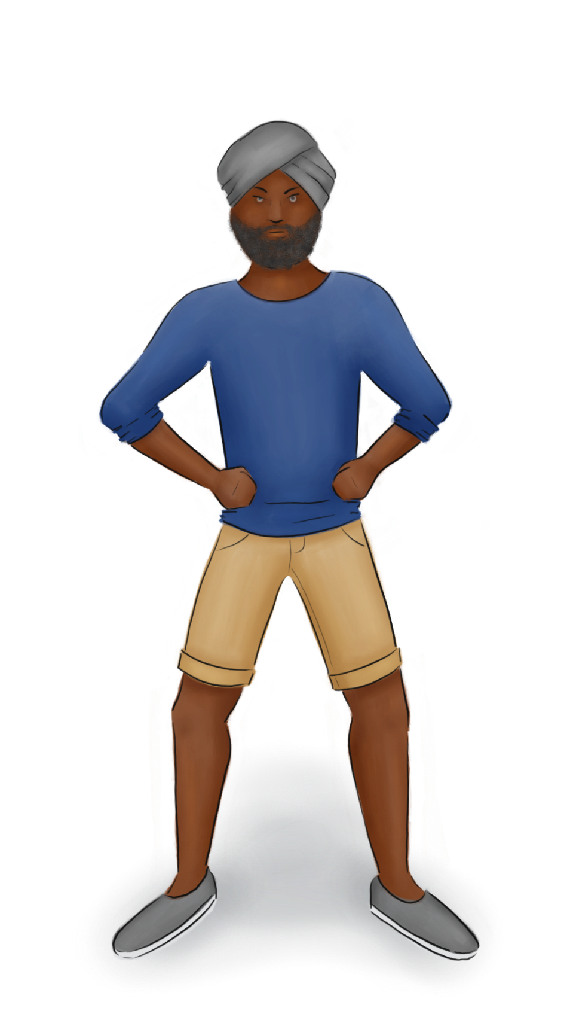
Dwarf Personas
Grumpy
The Angry One
Impatient
Easily annoyed / frustrated
Prone to “rage clicking” and device shaking
Likely to complain publicly and abandon a product based on one bad experience
Resistant to change
“Why is everyone so incompetent?”

Slide 15
Dwarf Personas
Grumpy
The Angry One
Impatient
Easily annoyed / frustrated
Prone to “rage clicking” and device shaking
Likely to complain publicly and abandon a product based on one bad experience
Resistant to change
“Why is everyone so incompetent?”
Ideas to develop further:
Situation: Having a bad day; manipulating and analysing a large data set using a spreadsheet app
Priority: Reliability
Impact:
  App crashes => data / changes lost
  Long processing times => frustration, wasted time
Could also be The Disgruntled One
aka: Bad Actor / Security Threat

