Slide 1
Circles Workshop:
Sharing Responsibilities
Cassandra H. Leung | www.cassandrahl.com | @Tweet_Cassandra

Slide 2
Agenda
Introduction
  The Need
  The Challenges
Potential Solutions
  RACI Matrix
  Circles
Creating Testing Circles
  The Format
  Workshop
Next Steps

Slide 3
Our Needs
Team needs:
  Good organisation
  Fair and sensible division of work
  All bases covered
  Awareness of other testers‘ work
Individual needs:
  Sense of responsibility and ownership
  Sense of adding value
  Opportunities to learn and teach

Slide 4
What Obstacles Exist?
Team size
Individual time on the project
Physical location
Individual expertise
Individual interests

Slide 5
Solution
Let‘s get organised!
But how?

Slide 6
RACI Matrix

Slide 7
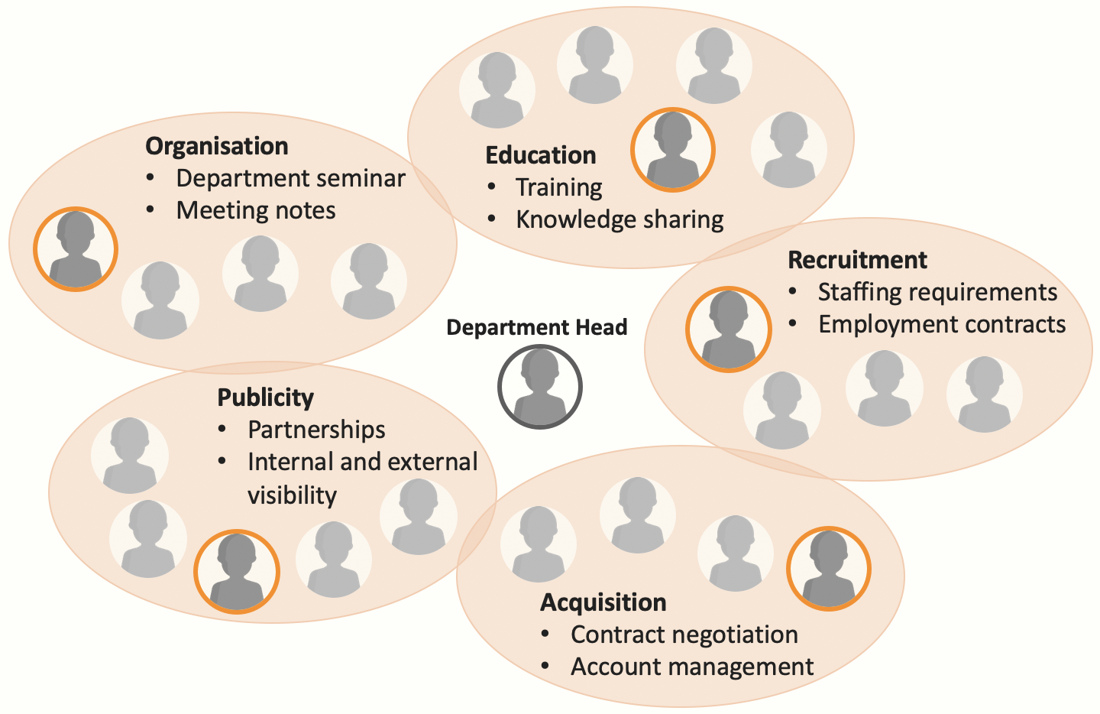
Circles

Slide 8
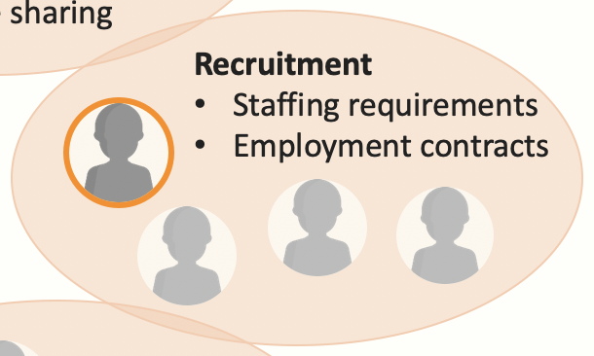
What are Circles?
Used at MaibornWolff (original creator of format unknown)
A practical structure for sharing responsibilities
An easy way of seeing who you can speak to about what
Topics are clustered into themes, which are the circles
Circles consist of:
  One lead (responsible)
  Interested supporters (first
  line supporters)
  (Testing circles will have
  teachers and learners too)
Second line supporters are team members outwith the circle

Slide 9
Creating Testing Circles
Workshop format:
Collect topics and cluster into themes (~20m)
Map interests and expertise (~5m)
Discuss feasibility and assign leads (~20m)

Slide 10
Collect and Cluster (~20m)
https://www.webwhiteboard.com/
Collect topics on your own
  Yellow note = task / responsibility
  Red note = challenge
Cluster topics together
  Aim: Five theme clusters (circles)
  Challenges kept separate unless specific to one topic

Slide 11
Map (~5m)
What do you want to learn?
  Purple note against the appropriate circle
  Include your name and the topic
  At least two each
What can you teach?
  Green note against the appropriate circle
  Include your name and the topic
  At least two each

Slide 12
Discuss and Assign (~20m)
Every circle should have:
  At least one teacher (green note)
  At least two people
Each circle should be feasible
  What is the predicted workload?
  What is the predicted availability?
  Is it realistic for these people to manage this circle?
  Who has too much / not enough work?
Every circle needs a lead
  Each tester should lead one circle
  Learners can also lead a circle!

Slide 13
What Do Leads Do?
A lead is like a primary contact person and should always be able to provide an update on the current status of their circle (e.g., in the weeklies)
Leads are responsible for keeping the circle organised and delivering, but do not make all the decisions
Leads should be able to delegate tasks and request support, including from those outside the circle
Leads are not responsibile for doing all the work!

Slide 14
Admire Our Circles
Do we have a good starting point?
Do we understand what is expected from us as:
  Leads
  Teachers
  Learners
  Team members?
Do we need a way to track the work we do outside of Jira?
  e.g., “To Dos“ tab in the Testing Teams channel

Slide 15
Next Steps
Document our new circles
Review by testing sub-team
Presentation of testing circles complete team

Slide 16

Circles Example
Exploratory Testing
Testing on physical machines
Session-based test management
Planning & Analysis
Test planning
Requirements analysis
Tool-Assisted Testing
Test automation
API testing
Lead
Documentation
User documentation
Technical documentation
Teacher
Project Management
Project reporting
Resource planning
Learner
Icons made by Freepik from www.flaticon.com

